Slide 1
MA3077 (DLI) Operational Research Lecture 21: Finite calling population
Dr Marco Fasondini

Slide 2
Recapitulation and lecture outline
Recap: in the last lecture we studied the M/M/s/K model,
In this lecture: The M/M/s model with finite calling population, following Ch. 17.6 of the book by Hillier and Lieberman.

Slide 3
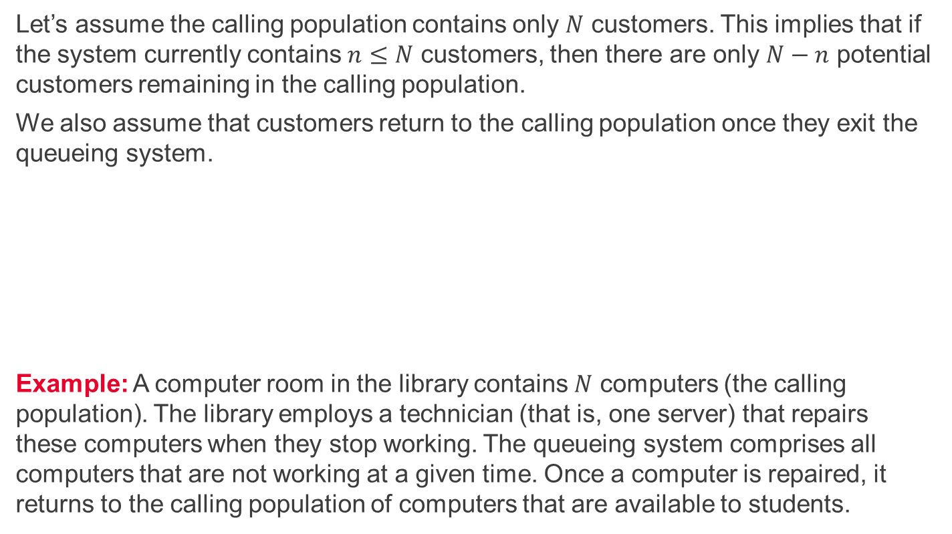
The M/M/s model with finite calling population
Let’s assume the calling population contains only $N$ customers. This implies that if the system currently contains $n≤N$ customers, then there are only $N−n$ potential customers remaining in the calling population.
We also assume that customers return to the calling population once they exit the queueing system.
Example: A computer room in the library contains $N$ computers (the calling population). The library employs a technician (that is, one server) that repairs these computers when they stop working. The queueing system comprises all computers that are not working at a given time. Once a computer is repaired, it returns to the calling population of computers that are available to students.

Slide 4
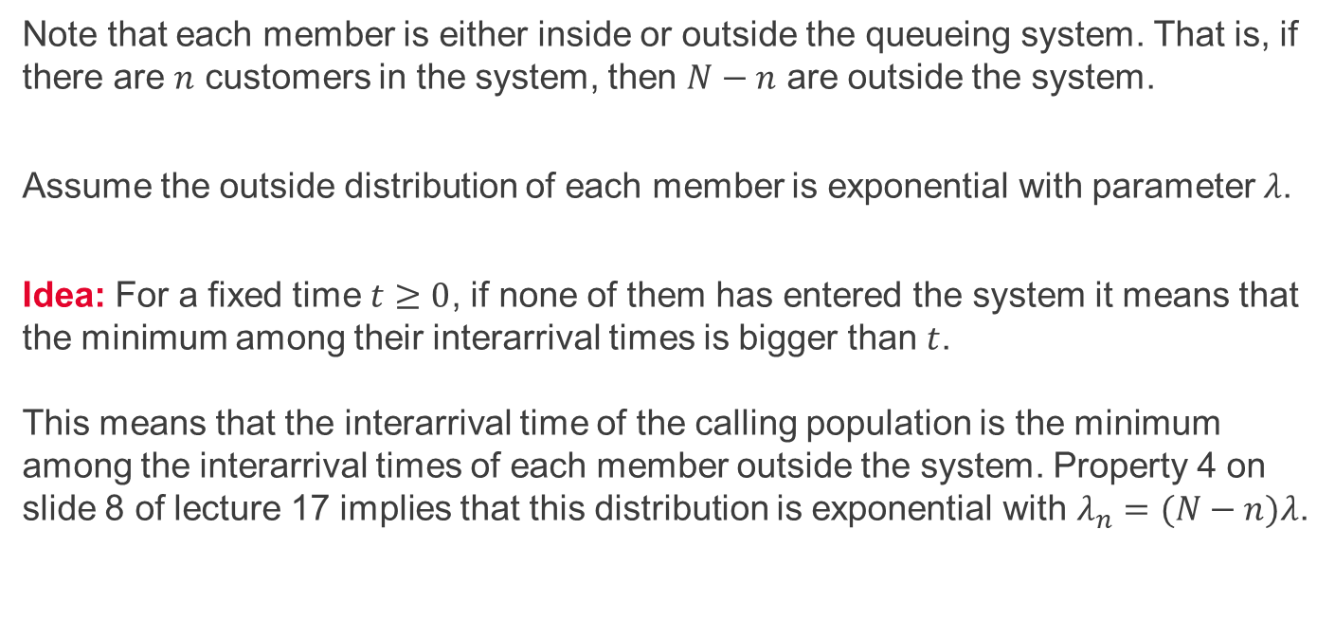
Interarrival time
Note that each member is either inside or outside the queueing system. That is, if there are $n$ customers in the system, then $N−n$ are outside the system.
Assume the outside distribution of each member is exponential with parameter $λ$.
Idea: For a fixed time $t≥0$, if none of them has entered the system it means that the minimum among their interarrival times is bigger than $t$. This means that the interarrival time of the calling population is the minimum among the interarrival times of each member outside the system. Property 4 on slide 8 of lecture 17 implies that this distribution is exponential with $λ_{n}=(N−n)λ$.

Slide 5
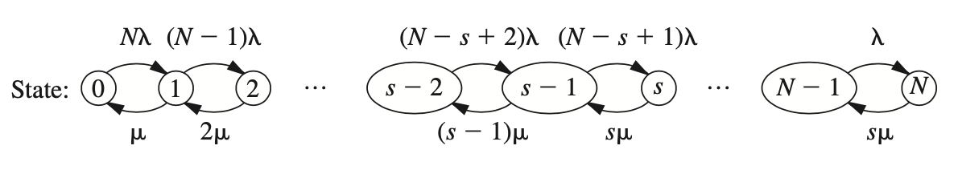
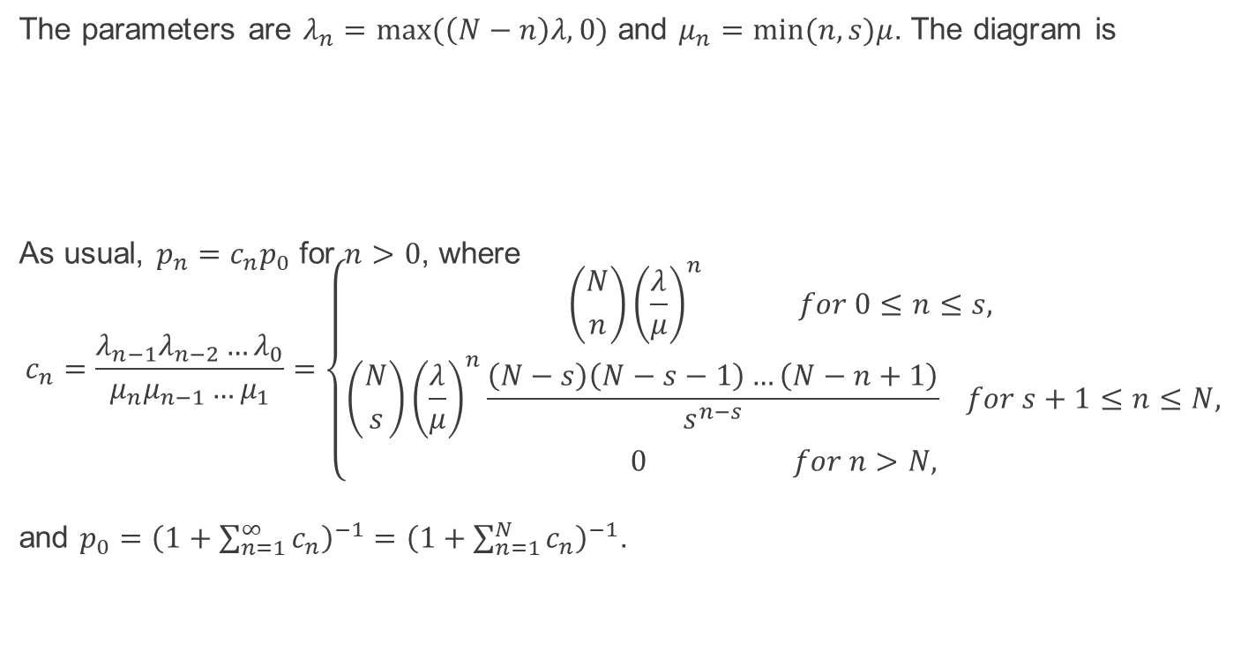
Using birth-and-death processes
The parameters are $λ_{n}=max⁡(\left(N−n\right)λ,0)$ and $μ_{n}=min⁡(n,s)μ$. The diagram is
As usual, $p_{n}=c_{n}p_{0}$ for $n>0$, where $$c_{n}=\frac{{λ_{n−1}λ_{n−2}…λ}_{0}}{μ_{n}μ_{n−1}…μ_{1}}=\left\{\begin{aligned}\left({N \atop n}\right){\left(\frac{λ}{μ}\right)}^{n} for 0≤n≤s, \\ \left({N \atop s}\right){\left(\frac{λ}{μ}\right)}^{n}\frac{\left(N−s\right)\left(N−s−1\right)…\left(N−n+1\right)}{s^{n−s}} for s+1≤n≤N, \\ 0 for n>N,\end{aligned}\right.$$
and $p_{0}={\left(1+\sum_{n=1}^{∞}{c_{n}}\right)}^{−1}=$ ${\left(1+\sum_{n=1}^{N}{c_{n}}\right)}^{−1}$.

Slide 6
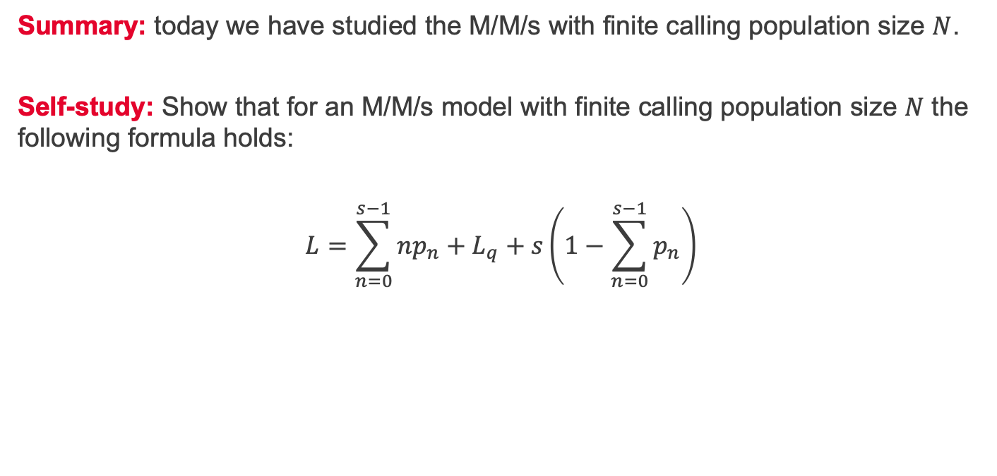
Summary and self-study
Summary: today we have studied the M/M/s with finite calling population size $N$.
Self-study: Show that for an M/M/s model with finite calling population size $N$ the following formula holds:
$$L=\sum_{n=0}^{s−1}{np_{n}}+L_{q}+s\left(1−\sum_{n=0}^{s−1}{p_{n}}\right)$$

